Slide 1
voxcinema
voxcinema
Voxcinema

Slide 2




Voxcinema
Home
New Release
DVD
Search
Group 5
CINEMA APPLICTION
Vox cinema application
A cinema application that allows the user to book a movie and choose from the menu provided by the movie theater.
Resume
+
My List
OVERVIEW:
The purpose of the project
The function of each class
Future aspirations of the project

Slide 3


Voxcinema
Home
New Release
DVD
Search
Group 5
CINEMA APPLICTION
Vox cinema application
A cinema application that allows the user to book a movie and choose from the menu provided by the movie theater.
Resume
+
My List
OVERVIEW:
The UML of the project
Pictures of the Output

Slide 4
voxcinema
Home
New Release
Search
Group 5
DVD
The purpose of the project
Every project have a purpose and we had a lot in mind while creating this application so here's a few points that we focused on to be the main purpose for the application
01

Slide 5

voxcinema
Home
New Release
DVD
Search
Group 5
The purpose of the project
Point 1 : facility
Explanation :
Facilitate the user's entertainment using technology
Resume
+
My List

Slide 6
voxcinema
Home
New Release
DVD
Search
Group 5
The purpose of the project
Point 2 : Minimizing
Explanation :
Reducing crowding at the cinema entrance by providing reservations through the app
Resume
+
My List

Slide 7
voxcinema
Home
New Release
DVD
Search
Group 5
The purpose of the project
Point 3 : Provide comfort
Explanation :
Providing comfort and increase of privacy for the users
Resume
+
My List

Slide 8

voxcinema
Home
New Release
DVD
Search
Group 5
The purpose of the project
Abbreviation in 3 points
Point 1 : facility
Point 2 : Minimizing
Point 3 : Provide comfort
10
HD

Slide 9

voxcinema
Home
New Release
Search
Group 5
DVD
The function of each class
The project have 5 classes each one have its own job in running the application
CinemaApplictaion (Main)
CinemaInterface
CinemaPersonalAccount
Movies
CinemaFood
02

Slide 10

voxcinema
Home
New Release
DVD
Search
Group 5
The function of each class
CinemaApplication
Explanation :
The main class in the project, and in charge of running the class objects and creating methods.
Resume
+
My List

Slide 11
voxcinema
Home
New Release
DVD
Search
Group 5
The function of each class
CinemaInterface
Explanation :
The Unified interface for creating the whole cinema Application .
Resume
+
My List

Slide 12
voxcinema
Home
New Release
DVD
Search
Group 5
The function of each class
CinemaPersonalAccount
Explanation :
This class have the user personal information saved, and print the information if asked
Resume
+
My List

Slide 13
voxcinema
Home
New Release
DVD
Search
Group 5
The function of each class
Movies
Explanation :
This class prints the movies list (Name, time, language…etc) and allows the user to book and pay for the movie, and print the QR code that allows the user to enter the movie theater
Resume
+
My List

Slide 14
voxcinema
Home
New Release
DVD
Search
Group 5
The function of each class
CinemaFood
Explanation :
This class is in charge of printing the menu of the cinema restaurant for the user and prints the bills for the order
Resume
+
My List

Slide 15

voxcinema
Home
New Release
DVD
Search
Group 5
The function of each class
5 classes in total
CinemaApplication
CinemaInterface
CinemaPersonalAccount
Movies
CinemaFood
10
HD

Slide 16

voxcinema
Home
New Release
Search
Group 5
DVD
Future aspirations of the project
We aspire to grow and develop our application in the near future so here what we hope to achive
03

Slide 17

voxcinema
Home
New Release
DVD
Search
Group 5
Future aspiration of the project
1: More restaurants
Explanation :
Increase of number for the restaurants that can the user pick his\her food from
Resume
+
My List

Slide 18
voxcinema
Home
New Release
DVD
Search
Group 5
Future aspiration of the project
2: More Attenders
Explanation :
The user can book for people other than him\her self at the same time
Resume
+
My List

Slide 19
voxcinema
Home
New Release
DVD
Search
Group 5
Future aspiration of the project
3: More venues
Explanation :
The user can book for different branches in his\her surrounding area and book the theater he\she wants
Resume
+
My List

Slide 20

voxcinema
Home
New Release
Search
Group 5
DVD
The UML of the project
The relations between the classes and methods explained simply.
04

Slide 21
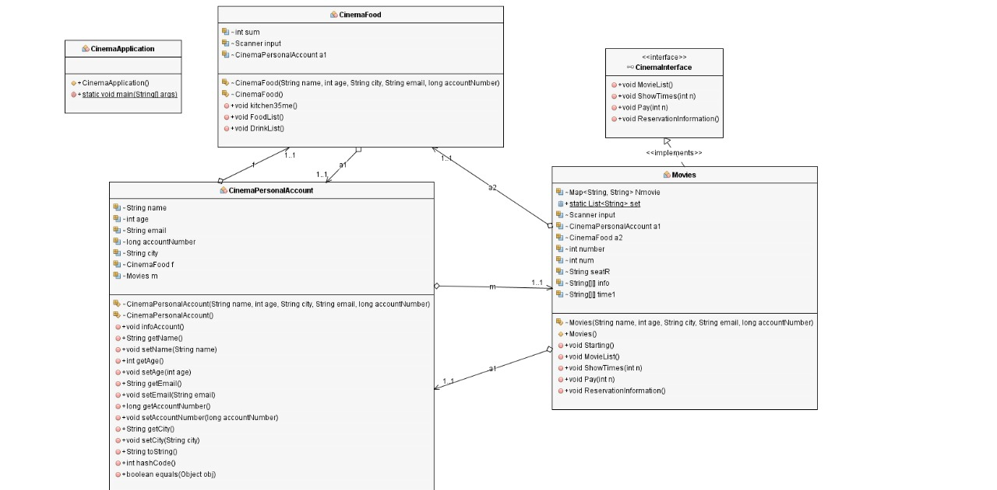

Slide 22

voxcinema
Home
New Release
Search
Group 5
DVD
Pictures of the Output
Pictures of what willl the output look like to the user while using the application
05

Slide 23
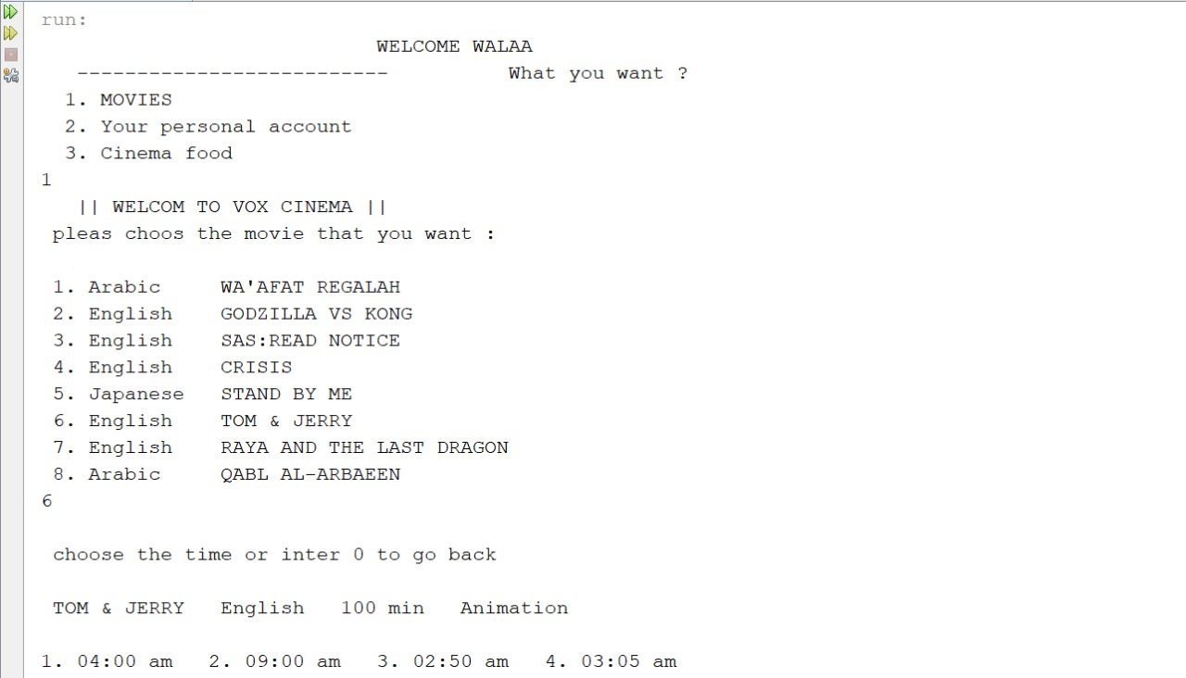

Slide 24
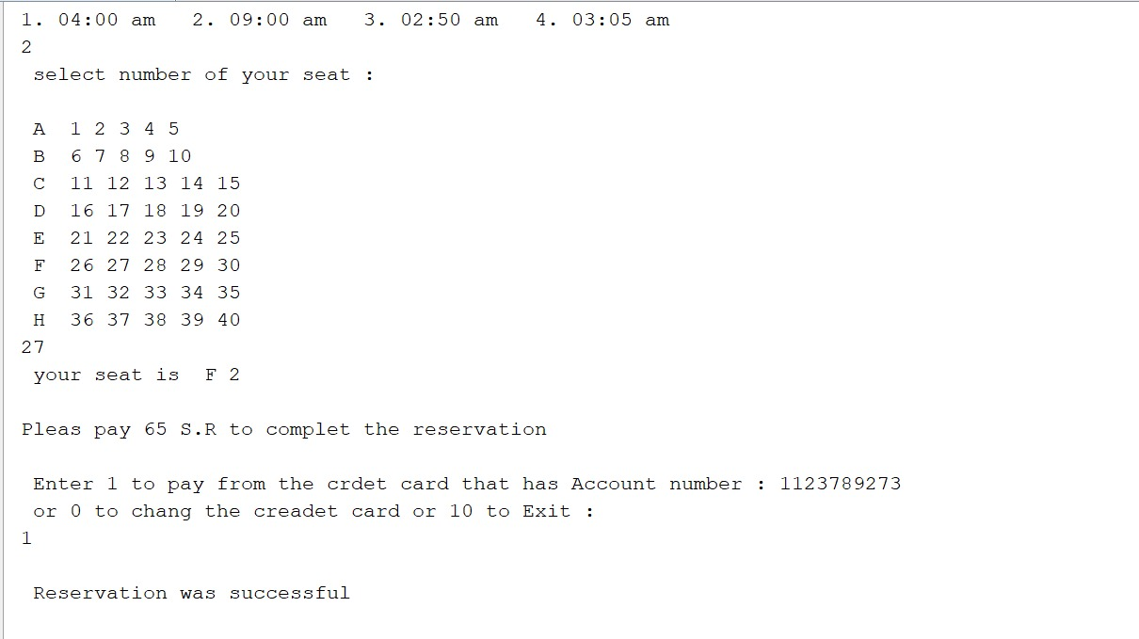

Slide 25
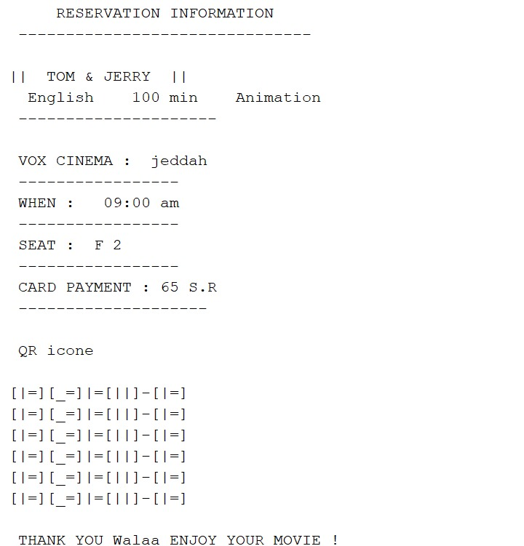

Slide 26
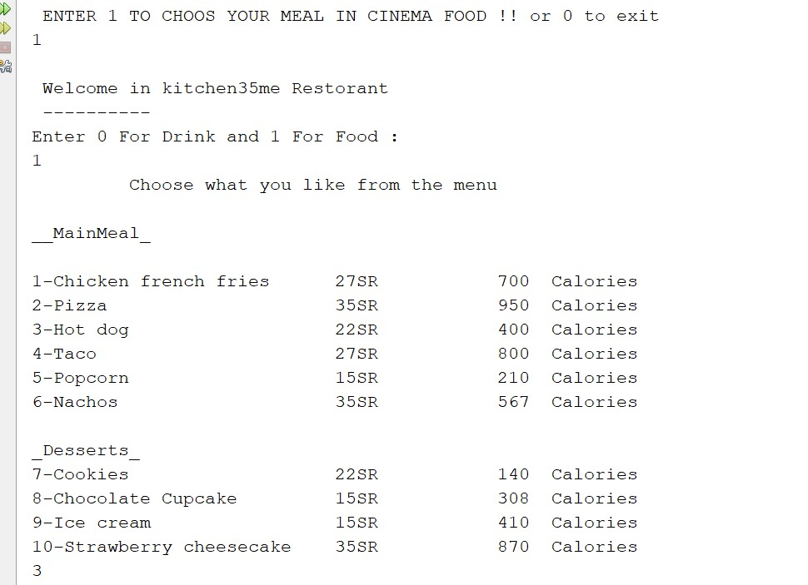

Slide 27
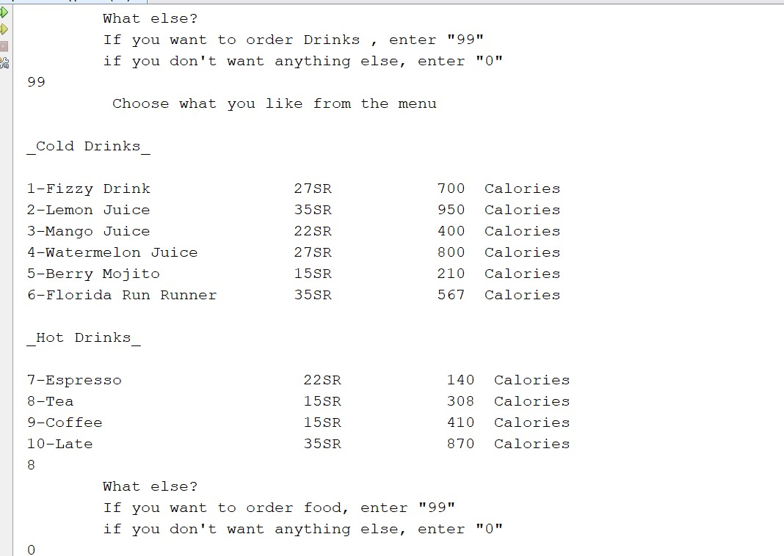

Slide 28
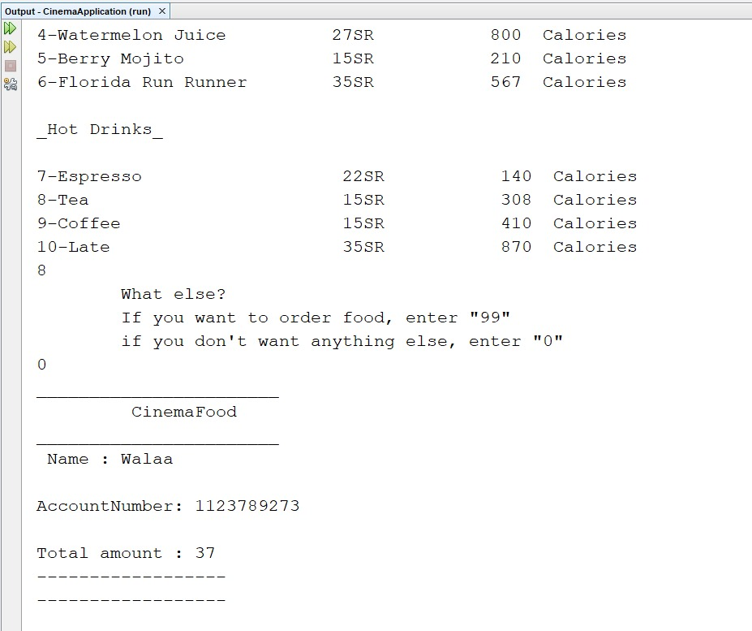

Slide 29
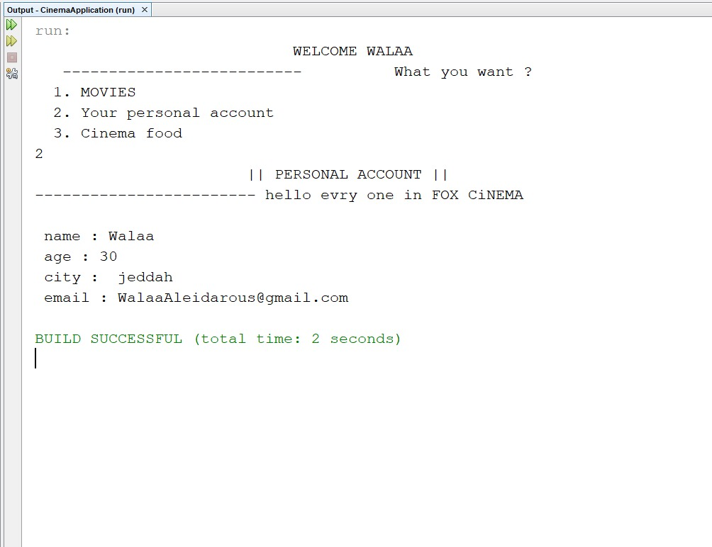

Slide 30

voxcienma
Home
New Release
DVD
Search
Group 5
See you on
next report.
Thank’s for your time and attention
SIGN OUT

